Slide 1
Segment Model Concepts
Dan Ganser
03/10/2015

Slide 2

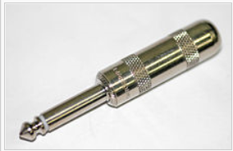
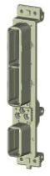
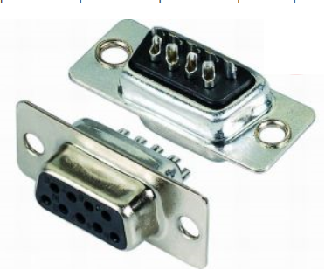
Sample Harness Definition
H1
H1.a
H1.b
N1
N5
Terminal lug
lug1
S1
splice1
phone1
Phone connector (6,35mm)
S3-1
S3-2
S4
N3
X4
X1
S3
N4
X2
S2-1
C1
Connector with inserts + backshell with EMI
(ARINC600)
X3
C2
X6
N2
S2-2
S5
N6
S2-3
S2
S3-a
S3-b
X7
arinc1
dsub1
DSUB9
Wire list 1 (simplified)
W1,2 Coax R2 – R6
W3,4 Coax R2 – R6
W5 Single R2 – R6, splice at N3
W6 Shield R2 – N4
W7 Single N3/splice – R1
W8,9 SpeakerWire R2 – R5
S5 grouped by lacing
C1 wrap covering
C2 HeatShrink covering
X6 and X7 for fixings
wire1: S2+S3+S5
wire2: S1
Cable1 (RG 58): S2+S3+S5
Cable2 (RG 58): S2+S3+S5
Cable3 (Speaker wire ): S2+S3+S4
wrap1 (protective covering): C1
Heatshrink1 (Heatshrink): C2
Braid1 (braid): S2+S3
[Lacing]: S5

Slide 3
Table of contents
Onion Model (Pure)
Onion Model (Hybrid)
Segment Model
Details of wires, etc. are contained in Word document Segment Model Concepts.docx
It may be of value to review the “4” slides for each model one after the other rather than one model at a time.

Slide 4
Onion (Pure)
H1
S1
Harness
G1
Null
W1
Segment
W2
Covering
W4
Group
CA1
Plastic
Content
G3
SHLD
W5
Order
W6
W7
This is a recursive approach that allows the definition of wires and cables.

Slide 5
Onion (Pure)
H1
S2
Distance d1 from N2
Harness
G4
Null
Segment
W3
Covering
Distance d1 from N2
G5
C2
Group
W3
Content
Distance d2 from N2
Order
G5
C2
G51
C1
W3

Slide 6
Onion (Pure)
H1
S3
Distance d5 from N4
G6
C2
Harness
G61
C1
W1
Segment
W2
Covering
W3
Group
CA1
Content
Distance d5 from N4
G7
Null
Order
W1
W2
W3
CA1

Slide 7
Onion (Pure)
H1
S4
Harness
G8
Null
Segment
W1
Covering
W3
Group
S5
Content
G9
Null
Order
W2
CA1

Slide 8
Onion (Hybrid)
H1
S1
Harness
G1
Null
W1
Segment
W2
Covering
W4
Group
CA1
Plastic
Content
G3
SHLD
W5
W6
W7
This is a recursive approach that allows the definition of wires and cables.

Slide 9
Onion (Hybrid)
H1
Distance d2 from N2
S2
O1
C1
Distance d1 from N2
Harness
C2
Segment
G4
Null
Covering
W3
Group
Content
Order

Slide 10
Onion (Hybrid)
H1
Distance d5 from N4
S3
O1
C1
Distance d5 from N4
Harness
C2
Segment
G7
Null
Covering
W1
Group
W2
W3
Content
CA1
Order

Slide 11
Onion (Hybrid)
H1
S4
Harness
G8
Null
Segment
W1
Covering
W3
Group
S5
Content
G9
Null
Order
W2
CA1

Slide 12
Segment
H1
S1
Harness
Content
W1
Segment
Content
W2
Covering
Content
W4
Group
Content
CA1
Content
Order

Slide 13
Segment (Defining Internal Cable)
CA1
Shield
Harness
SX1
O1
Plastic
Segment
Content
Covering
WX1
Content
WX2
Group
Content
WX3
Content
Order
This is a recursive approach that allows the definition of wires and cables.

Slide 14
Segment
Distance d2 from N2
H1
C1
S2
O2
C2
Harness
Distance d1 from N2
Segment
Content
W3
Covering
Group
Content
Order

Slide 15
Segment
H1
Distance d5 from N4
C1
S3
O2
Harness
C2
Distance d5 from N4
Segment
Content
Covering
W1
Content
W2
Group
Content
W3
Content
Content
CA1
Order

Slide 16
Segment
H1
S4
Harness
Content
W1
Content
Segment
W3
Covering
Group
S5
Content
Content
Order
W2
Content
CA1

